Slide 1
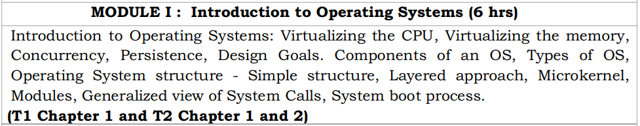
Operating Systems

Slide 2
Icebreaker Question
How many apps do you think are running on your laptop?
5?
10?
20?
Reality: 150 +
Open Task Manager / Activity Monitor / htop.
Count the processes

Slide 3
What are these processes?
Foreground processes
Background processes
System services (daemons)
Examples: Wi-Fi, Bluetooth, Notifications
Who started them?
If you didn’t start them… who did?
Operating System

Slide 4
OS = Manager
Manages CPU, Memory, Files, Devices, Security
Without OS → Chaos, With OS → Order
CPU runs one instruction at a time
But 150+ processes run
Because OS schedules them
CPU → Process 1 → Process 2 → Process 3
Fast switching gives illusion of parallelism

Slide 5
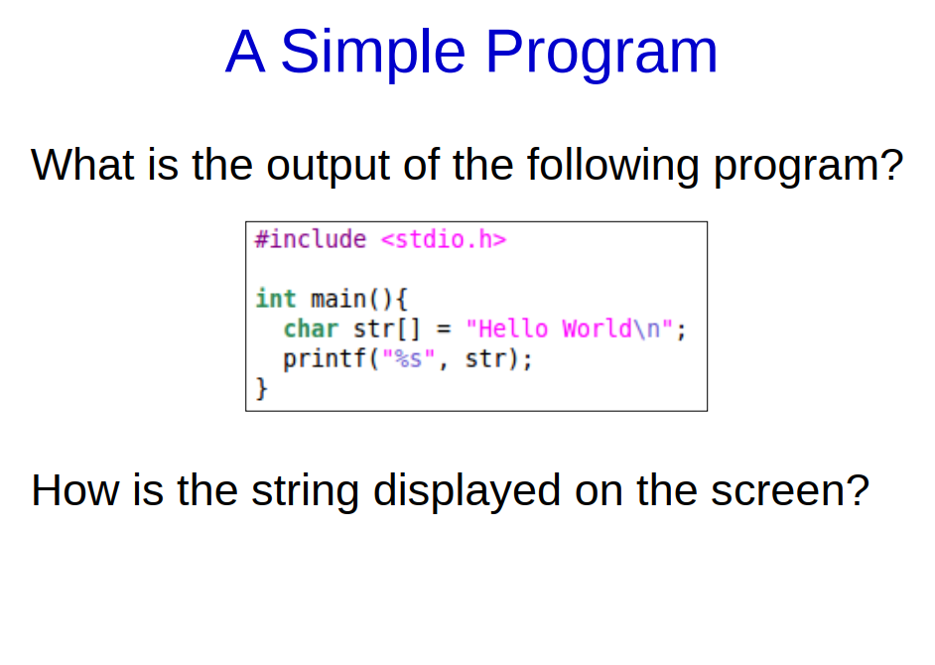
printf() → C Library → System Call → Kernel → Driver → Hardware → Display

Slide 6
printf() is not part of the OS. It belongs to the C Standard Library (glibc on Linux, msvcrt on Windows)
What it does:
Takes your format string
Performs formatting (convert integers, floats, etc.)
Stores characters temporarily in a buffer
printf() → C Library → System Call → Kernel → Driver → Hardware → Display

Slide 7
stdout is a file stream connected to your terminal
C library calls a low-level function (User Level)
User space cannot directly talk to hardware
Needs the OS kernel
To go into the kernel, it triggers a system call interrupt:
syscall instruction in modern systems
Switches the CPU from user mode → kernel mode.
OS is in charge
printf() → C Library → System Call → Kernel → Driver → Hardware → Display

Slide 8
Kernel Validates and Processes the Request
Kernel Writes to the Terminal Driver
Driver Converts Text into Pixel / Character Data
If GUI mode:
The terminal emulator receives the bytes
The terminal emulator uses GPU driver to draw characters
If text mode (rare today):
Driver writes characters to VGA memory
printf() → C Library → System Call → Kernel → Driver → Hardware → Display

Slide 9
GPU receives draw commands
GPU writes pixels into the framebuffer
Framebuffer is scanned out to your monitor at 60Hz
Hello World appear
With OS:
You write one line of code
OS handles memory, CPU mode switching, drivers, GPU, scheduling, protection
Without OS:
YOU must handle everything manually
Even one character requires deep system and hardware programming
printf() → C Library → System Call → Kernel → Driver → Hardware → Display

Slide 10
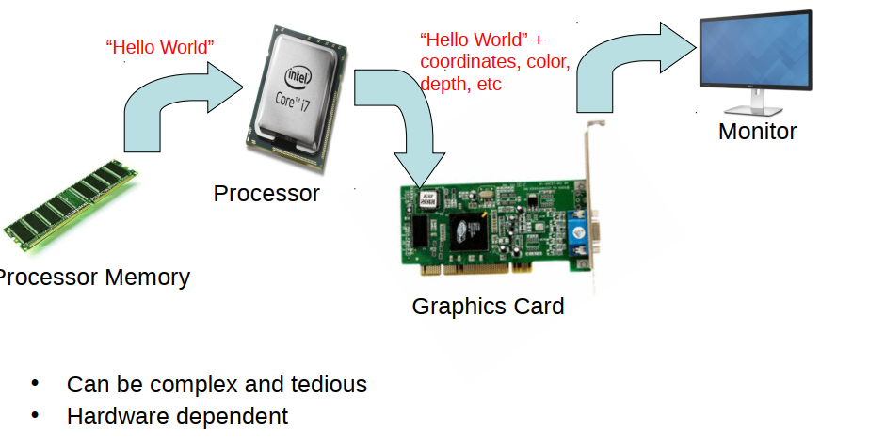
What happens if no OS is present?

Slide 11
Without an OS, EVERYTHING is Your Responsibility
In a normal system:
OS initializes CPU
OS sets up memory
OS configures GPU
OS loads drivers
OS provides APIs (printf, write)
OS draws to the screen
Without an OS, NONE of this exists
Your CPU powers on to a blank environment

Slide 12
Sample Scenario
Print a character:
You must write to a hardware port (VGA text mode):
mov ax, 0xB800
mov es, ax
mov di, 0
mov al, 'H'
mov ah, 0x07 ; color
mov [es:di], ax
Writes the letter H to the top-left pixel of screen memory.
There is:
No printf()
No terminal
No fonts except VGA hardware font
You must manage cursor, scrolling, colors manually

Slide 13
YOU must configure the GPU manually
The GPU does NOT show anything unless:
You set the right graphics mode
Allocate a framebuffer
Write pixel values yourself
Refresh the display
YOU must draw text manually
Load a font bitmap
Convert characters to pixel matrices
Write pixels to framebuffer
Handle newlines
Handle scrolling
Handle colors
Handle screen clearing

Slide 14
Just to show “Hello World” on screen, you write hundreds of lines of assembly + C.
With OS (easy):
printf → OS → driver → GPU → monitor You do 1 line of code

Slide 15
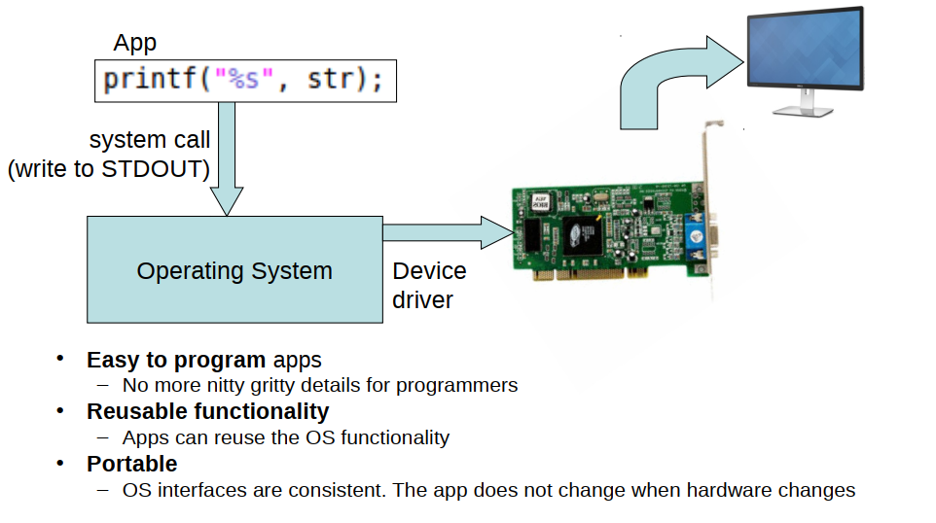
Operating Systems: Abstraction

Slide 16
Why study operating systems ?
What exactly happens when you run a user program?
How to make your program run faster and more efficiently?
How to make your programs more secure, reliable, tolerant to failures?
Why is your program running slowly and how to fix it?
How much CPU/memory is your program consuming, and why?
OS expertise is one of the most important skills when building high performance, robust, complex real-life systems

Slide 17
What is a program?
User program = code (instructions for CPU) + data to do a specific task
Stored program concept
User programs stored in main memory (instructions + data)
Memory is byte-addressable: data accessed via memory address CPU fetches code/data from memory using address, and executes instruction
CPU runs processes = running programs
Modern CPUs have multiple cores for parallel execution
Each core runs one process at a time each

Slide 18
Running a C program
C code translated into executable by compiler
Executable file stored on hard disk (say, “a.out”)
When executable is run, a new process is created
Process allocated space in RAM to store code and data
CPU starts executing the instructions of the program
When CPU is running a process, CPU registers contain the execution context of the process
PC points to instruction in the program, general purpose registers store data in the program, and so on

Slide 19
Virtualizing the CPU
#include <stdio.h> #include <stdlib.h> int main()
{
char *str=“ab”;
while(1)
{
sleep(1);
printf(“%s\n”, str);
}
return 0;
}
Save as os1.c
Compile: gcc os1.c –o os1
Run: ./os1
Output
ab
ab
ab
.
.
.

Slide 20
Virtualizing the CPU
#include <stdio.h> #include <stdlib.h> int main()
{
char *str=“ab”;
while(1)
{
sleep(1);
printf(“%s\n”, str);
}
return 0;
}
Save as os1.c
Compile: gcc os1.c –o os1
Run: ./os1 & ./os1 & ./os1&
Output
[2] 7640
[3] 7641
[4] 7642
ab
ab
ab
…

Slide 21
Virtualizing the CPU
#include <stdio.h> #include <stdlib.h> int main(int argc, char *argv[])
{
char *str=argv[1];
while(1)
{
sleep(1);
printf(“%s\n”, str);
}
return 0;
}
Save as os1.c
Compile: gcc os1.c –o os1
Run: ./os1 A
Output
A
A
A A
A
.
.
.

Slide 22
Virtualizing the CPU
#include <stdio.h> #include <stdlib.h> int main(int argc, char *argv[])
{
char *str=argv[1];
while(1)
{
sleep(1);
printf(“%s\n”, str);
}
return 0;
}
Save as os1.c
Compile: gcc os1.c –o os1
Run: ./os1 A & ./os1 B& ./os1 C&
Output
[1] 7873
[2] 7874
[3] 7875
A
C
B
A
B
C
C
B
A
….

Slide 23
Virtualizing the CPU
Operating system, with some help from the hardware, is in charge of this illusion
Illusion that the system has a very large number of virtual CPUs
Policy of OS
Turning a single CPU into a seemingly infinite number of CPUs
Allowing many programs to seemingly run at once is what we call virtualizing the CPU

Slide 24
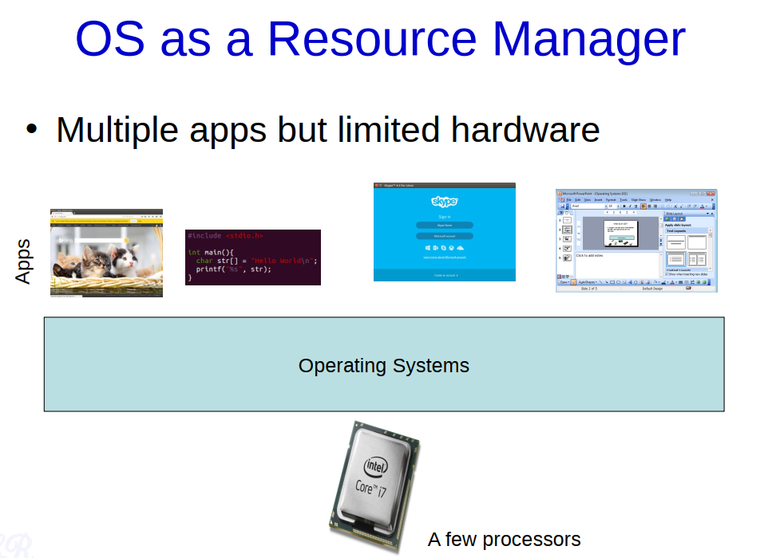

Slide 25
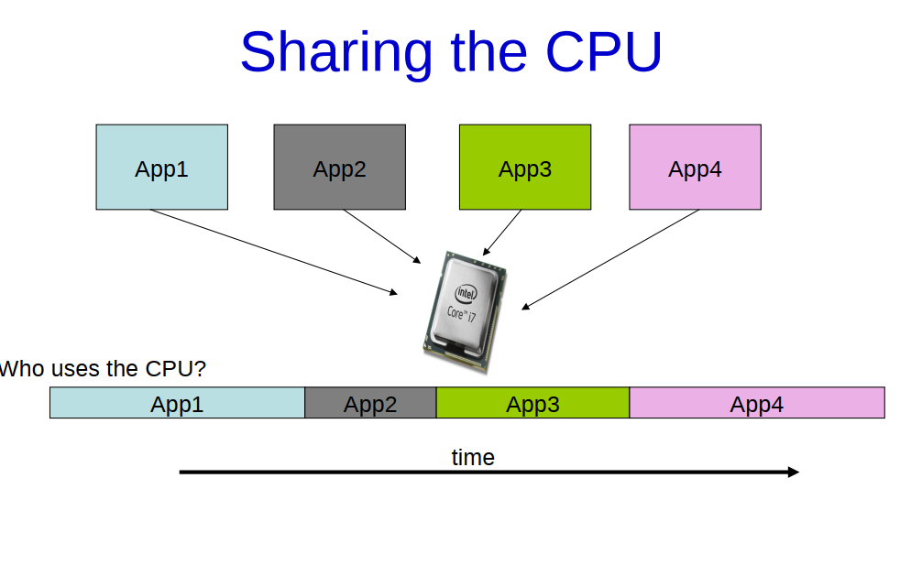

Slide 26
Virtualizing the Memory
#include <unistd.h> #include <stdio.h> #include <stdlib.h> int main(int argc, char *argv[]) { int *p = malloc(sizeof(int)); printf("(%d) address of p: %x\n",getpid(), (unsigned) p); *p = 0; int i=0; while (1) { sleep(1); *p = *p + 1; printf("(%d) p: %d\n", getpid(), *p); } return 0; }

Slide 27
Virtualizing the Memory
Save as os2.c
Compile it: gcc os2.c –o os2
Run: ./os2
Output
(10344) address of p: cf8962a0
(10344) p:1
(10344) p:2
(10344) p:3
(10344) p:4
(10344) p:5
.
.
.
.

Slide 28
Virtualizing the Memory
Save as os2.c
Compile it: gcc os2.c –o os2
Run: ./os2 & ./os2 &
Output
(10828) address of p: 43be52a0
(10829) address of p: 161882a0
(10828) p:1
(10829) p:1
(10829) p:2
(10828) p:2
(10828) p:3
(10829) p:3
.
.
.
.
.

Slide 29
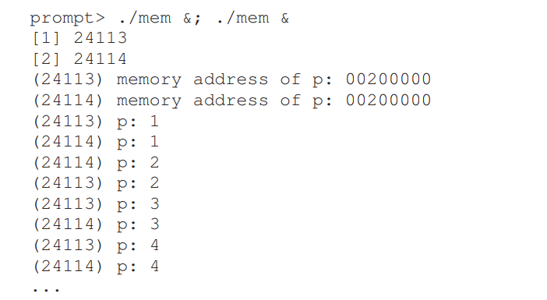

Slide 30
Concurrency
Concurrency is the execution of the multiple instruction sequences at the same time.
Capability of an OS to handle more than one task or process at the same time, thereby enhancing efficiency and responsiveness.
Allows several tasks to be in progress at the same time, either by running on separate processors or through context switching on a single processor

Slide 31
Concurrency
Physical resource Sharing: Multiuser environment since hardware resources are limited
Logical resource Sharing: Shared file (same piece of information)
Computation Speedup: Parallel execution
Modularity: Divide system functions into separation processes

Slide 32
Persistence
Any data that the user wants to survive a system power-off needs to be written to persistent storage.
Usually persistent storage, either mechanical or SSD, forms the bottom tier of the memory hierarchy.
It is up to the OS to impose structure.
The OS subsystem responsible for organising persistent storage is known as the file system.
A file system groups related data into a single unit known as a file.
The file system will provide some way of structuring files and expressing their relations to one another.

Slide 33
Design Goals
What an OS does:
Takes physical resources, such as a CPU, memory, or disk, and virtualizes them
Handles tough and tricky issues related to concurrency
Stores files persistently, thus making them safe over the long-term.

Slide 34
Design Goal 1
Build up some abstractions in order to make the system convenient and easy to use
Abstraction makes it possible to write a large program by
dividing it into small and understandable pieces
Write such a program in a high-level language like C without thinking about assembly
Write code in assembly without thinking about logic gates
Build a processor out of gates without thinking too much about transistors.

Slide 35
Design Goal 2
Design and implementing an operating system to provide high performance
Another way to say this is our goal is to minimize the overheads of the OS

Slide 36
Design Goal 3
Provide protection between applications, as well as between the OS and applications.
Make sure that the malicious or accidental bad behavior of one does not harm others
Don’t want an application to be able to harm the OS itself
Protection is at the heart of one of the main principles underlying an operating system: Isolation
Isolating processes from one another is the key to protection and thus underlies much of what an OS must do

Slide 37
Design Goal 4
Operating system must run non-stop
When it fails, all applications running on the system fail as well
Operating systems often strive to provide a high degree of reliability

Slide 38
Other Design Goals
Energy-efficiency is important in our increasingly green world
Security (an extension of protection, really) against malicious applications is critical, especially in these highly-networked times
Mobility is increasingly important as OS are run on smaller and smaller devices

